Slide 1
LLMs With Graphs

Slide 2
Introduction
LLMs, with their proven efficacy in NLP tasks and beyond, offer rich node representations and complex reasoning capabilities, making them promising for enhancing GNNs.
The paper explores the utility of LLMs for interpreting text-attributed graphs (TAGs) as enhancers and predictors.
The paper presents observational findings of LLMs for node classification on TAGs

Slide 3
GNNs for graph ML
Graph Neural Networks (GNNs) have emerged as a prominent technique for handling graph-structured data in the field of machine learning.
GNNs employ a message-passing mechanism to effectively capture the inherent structure of graphs and learn meaningful representations for individual nodes.
They have demonstrated remarkable success in a wide range of graph-related tasks, including node classification, link prediction, and graph classification.
Traditional pipelines for learning on graphs with textual node attributes often rely on non-contextualized shallow embeddings, such as Bag-of-Words and Word2Vec embeddings.
These shallow embeddings pose limitations in capturing general knowledge and in-depth semantic understanding of the textual content associated with nodes.

Slide 4
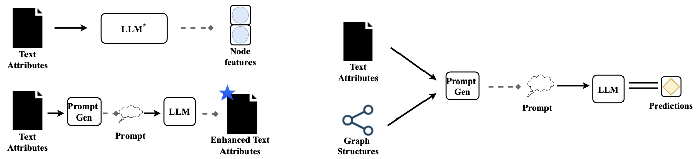
LLM types used
The proposed two ways of utilizing LLMs to perform node classification on TAGs are:
LLMs-as-Enhancers, and LLMs-as-Predictors.

Slide 5
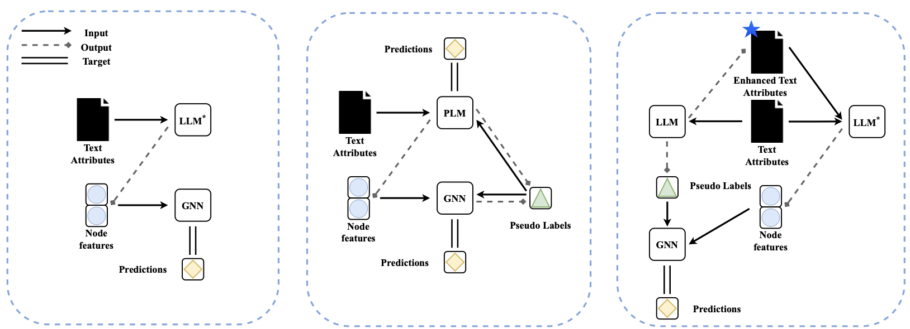
LLMs as Enhancers
This approach is to utilize the LLMs to extract features from text-attributed nodes within the graph, enriching them before feeding them into a GNN for graph learning.
LLM Feature Extraction Strategies proposed:
Cascading (left): LLMs extract features at multiple levels of the graph hierarchy.
Iterative (middle): LLMs refine features through iterative interaction with the GNN.
Text-Level Enhancement (right): LLMs enrich node features directly using surrounding text.

Slide 6
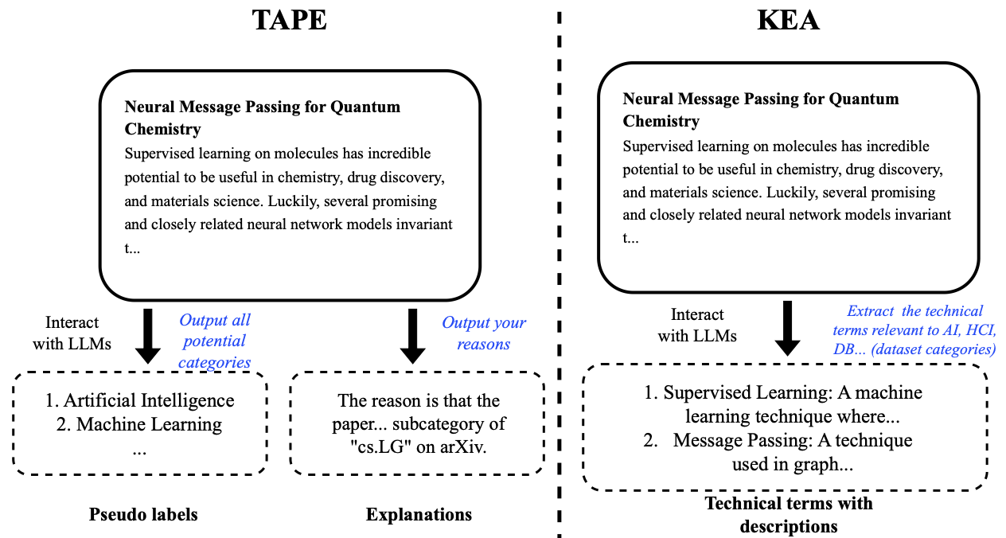
LLMs as Enhancers
Leveraging Pre-trained Knowledge of the LLMs, two strategies for augmentation are:
TAPE (Text-Augmented Pre-training Embedding): Incorporates external text relevant to the graph nodes.
KEA (Knowledge Enhanced Augmentation): Injects specific knowledge concepts related to the task.

Slide 7
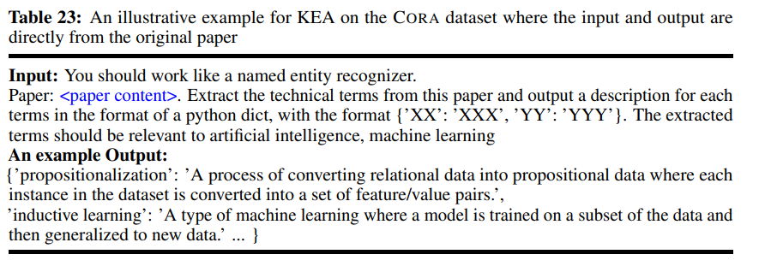
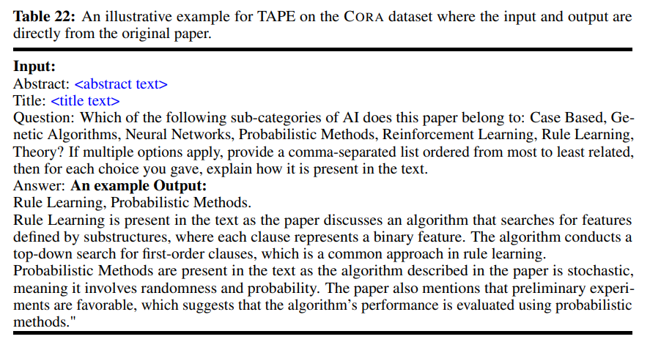
LLMs as Enhancers

Slide 8
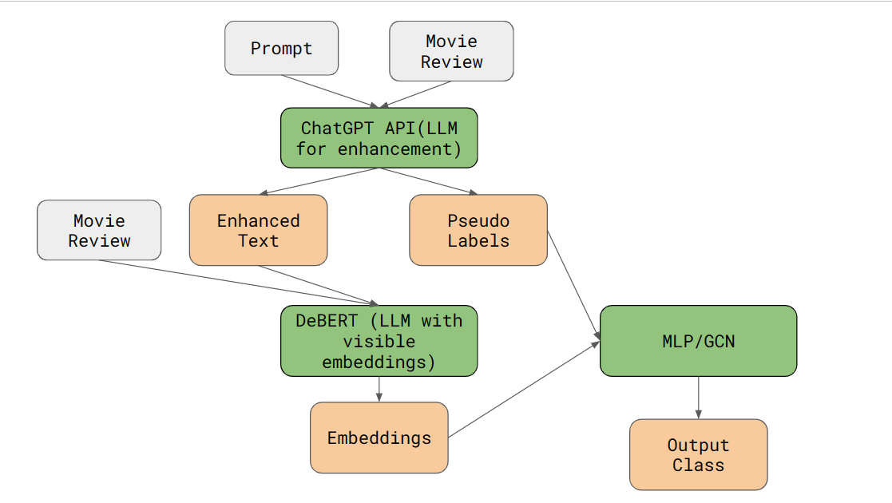

Slide 9
Finetuning of DeBERT
To get meaningful embeddings from DeBERT for our task, we have to finetune them.
Used pseudo labels to make DeBERT predict them and fine tuned based on them
We are giving only the pseudo labels of the training set as inputs
The output of the model is 768*2 vector (enhanced + original text embeddings concatenated together)
Pseudo labels is repeated 8 times to get a vector of 8 which is concatenated with finetuned embeddings and passed on to MLP- (768*2 +8 sized vector)

Slide 10
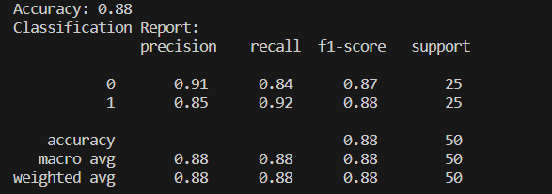
Results(only on validation)

Slide 11
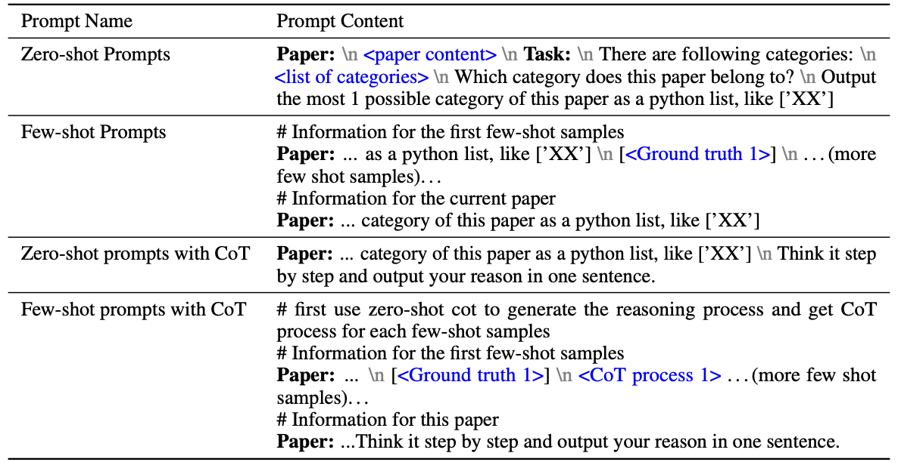
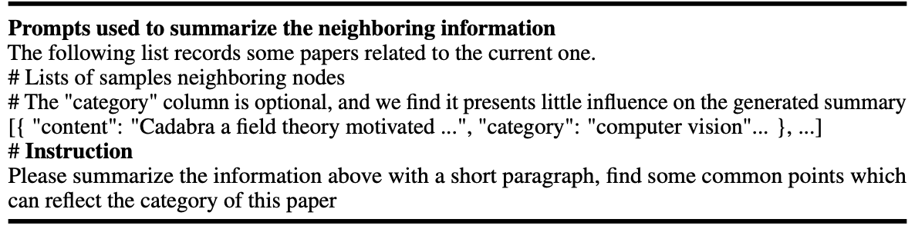
LLMs as Predictors
In this approach using only the LLM for the classification of each node, a prompt corresponding to the target TAG is generated both with and without structure (edge) information.
The generated prompt is input to the LLM and classification of each node is performed.
Example of prompt generation with additional structure information
Example of prompt generation without structure information

Slide 12
LLM types used
 | Advantages | Disadvantages
LLM-as-Enhancers | Effectively enhances text attributes at the feature level Improves performance of models in node classification tasks | May not be suitable for tasks that require prediction of node labels based on structural and attribute information
LLMs-as-Predictors | Directly employs LLMs to generate predictions Can potentially improve performance of models in node classification tasks | May be inaccurate in predictions Potential test data leakage problem

Slide 13
Observational findings of LLMs for node classification on TAGs
For LLMs-as-Predictors :
LLMs present preliminary effectiveness on some datasets.
Wrong predictions made by LLMs are sometimes also reasonable.
Chain-of-thoughts do not bring in performance gain.
There is potential test data leakage in evaluation.
Neighborhood summarization is likely to achieve performance gain.
LLMs with a structure-aware prompt may also suffer from heterophilous neighboring nodes.
The quality of pseudo labels is key to downstream performance.
Getting the confidence by simply prompting the LLMs may not work since they are too “confident”.
These experiments are performed on-
~ Datasets: CORA, Pubmed, OGBN-Arxiv, OGBN-Products
~ GNNs: GCN, GAT, RevGAT, GraphSAGE, SAGN, (and MLP)
~ LLMs: Deberta, LLaMA, Sentence-BERT, e5-large, text-ada-embedding-002 (OpenAI), and Palm-Cortex-001 (Google),

Slide 14
Observational findings of LLMs for node classification on TAGs
For LLMs-as-Enhancers :
Combined with different types of text embeddings, GNNs demonstrate distinct effectiveness.
Fine-tune-based LLMs may fail at low labeling rate settings.
With a simple cascading structure, the combination of deep sentence embedding with GNNs makes a strong baseline.
Simply enlarging the model size of LLMs may not help with the node classification performance.
For integrating structures, iterative structure introduces massive computation overhead in the training stage.
In terms of different LLM types, deep sentence embedding models present better efficiency in the training stage.
The effectiveness of TAPE is mainly from the explanations E generated by LLMs.
Replacing fine-tuned Pre-trained Language Models (PLMs) with deep sentence embedding models can further improve the overall performance of TAPE.
The proposed knowledge enhancement attributes KEA can enhance the performance of the original attribute TA.
For different datasets, the most effective enhancement methods may vary.

Slide 15
Conclusion
Key findings are as follows:
For LLMs-as-Enhancers, deep sentence embedding models present effectiveness in terms of performance and efficiency.
For LLMs-as-Enhancers, the combination of LLMs’ augmentations and ensembling demonstrates its effectiveness.
For LLMs-as-Predictors, LLMs present preliminary effectiveness but also indicate potential evaluation problem.

Slide 16
Implementation

